Slide 1

Coupled process and device modeling of Cu(In,Ga)Se₂ solar cells
Xiaofeng Xiang, David E.Sommer, Aaron Gehrke, Scott T.Dunham
University of Washington, Seattle, WA
Notes:
Hello everyone, I’m Xiaofeng, I’m a second year PhD student in Molecular Engineering program at the University of Washington. I’m very glad to present my work in the conference. The topic is about …

Slide 2

Introduction
First Generation: Monocrystalline/Polycrystalline silicon solar cells
Second Generation: Thin film solar cells (CIGS)
Advantages: low temperature coefficient, tunable bandgap, high absorption, 22.6% efficiency
Notes:
We know that monocrystalline and polystalline silicon solar cells is the first-generation technology. However, in spite of high efficiency of monocrystalline silicon PV, the manufacture cost is very high and sensitive to temperature. Polycrystalline silicon is cheap, but has lower efficiency. So, as clean energy demand rises in these years. The second-generation thin film solar cells becomes increasingly important, because it requires less materials in the manufacture but still has high efficiency. And CIGS is one of the most promising materials under this category. Recentyly, people have achieved more than 20% efficiency on CIGS. (CIGS photovoltaic (PV) modules can absorb ultraviolet and infrared radiation)

Slide 3
Point defects in CIGS solar cells
Vacancy
Antisite
V
Interstitial
Common defects in CIGS:
V_{Cu}, V_{Ga/In}, V_{se}, Cu_{Ga/In}, Ga_{Cu}/In_{Cu}, Cu_{i}, antisite complex, vacancy complex
Notes:
So our work is to better understand the defect in CIGS solar cells and we expect such defect engineering could help people understand the materials, the manufacture process and improve the solar cells performance. In the following picture, you see three types of defects in material. If there is absence of atom in a lattice, it is called a vacancy. If there is an atom occupies the position from other sublattice, it’s called an antisite. If the atom locates at the intermediate of lattice sites, then it’s called an interstital. Common defects in CIGS, deep level limits lifetime.

Slide 4
Defects in CIGS solar cells
Vacancy
Impurity/Antisite
V
Interstitial
Defect density distribution (kinetics, thermodynamics)
Shockley-Read-Hall recombination centers: Deep level defects (Cu_{Ga/In}, Ga_{Cu}/In_{Cu}, V_{Cu}+V_{Se} )
Notes:
What we want to know is the thermodynamic and kinetic process of these defects, so we can get defect distribution in CIGS. Then we know some deep level defects can be recombination centers and limit carrier lifetime, in that way, we are able to predict device performance.

Slide 5
Methods
Validation&Prediction
Thermodynamic&kinetic parameters
Experiment
Process simulation
/Device Simulation
Density functional theory (DFT)
Notes:
The methods consists of three parts. Firstly, we conduct DFT calculation to obtain the thermodynamic and kinetic parameters. And second step, when I obtained these values, I will implement them into process simulation, to see how defects diffuses and distributes. When I obtained the defect distribution, I will couple the distribution into device simulation, SRH model is used if they are deep level while ionization models is used if they are shallow dopant. And I will compare the process model and device simulation model with experiment. If they do not match, I will turn back to the first step to see if there is any possible route or major defects we are missing and improve the model.

Slide 6
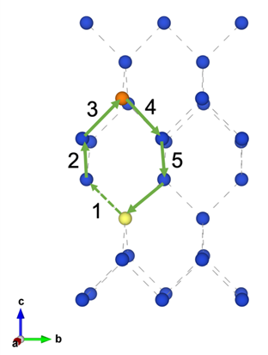
Defect diffusion in CIGS
[1]
Example vacancy diffusion pathway (green arrows) on the Cu sublattice leading to long range diffusion of a III_{Cu} defect (yellow).
[1] Sommer, David E., and Scott T. Dunham. ”Atomistic models of Cu diffusion in CuInSe2 under variations in composition.” Journal of Applied Physics 123.11 (2018): 115116.
Notes:
For the defect diffusion in CIGS, we are most interested in group I and group III atom diffusion. For the Group I, which is Cu, the diffusion is quite simple, they are diffusing through the mediation of Vcu. There are lots of Vcu in CIGS, however, very little VIII. So group III, which is in and ga, diffuse via other mechanisms. At this stage, we believe they diffuse through a Vcu-mediated mechanism. We found there are a binding energy between IIIcu and Vcu, so they can become defect complex. So it’s not hard for Vcu to find group III antisite. There are two possible routes for the group III diffusion. Direct and 3NN. As you see in the left picture, yellow one is III_cu, vacancy diffuse through 3NN and come to 5 sites, this would be a long range 3NN diffusion. If the vacancy at site 1 directly diffuse to site 5 through intersitial site, then it would be the direct diffusion. The Em values here are calculated by DFT.

Slide 7
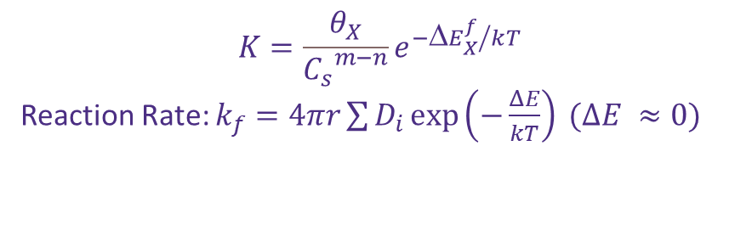

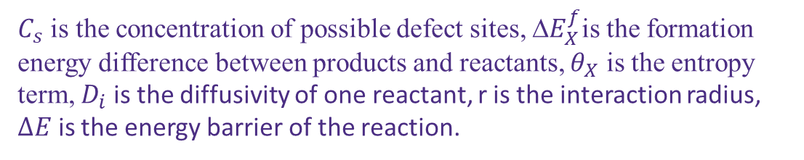
Continuum Modeling (Sentaurus Process)
$$Fick^{′}s First Law: J=−D∇C+uC∇U$$
$$Fick^{′}s Second Law:∂_{t}C=−∇∙J+R$$
$$Mass action Relations: R=k_{f} \left(\prod_{i=1}^{n}{C_{i}}−\frac{1}{K}∗{\left(\frac{p}{n_{i}}\right)}^{h}\prod_{j=1}^{m}{C_{j}}\right)$$
$$K=\frac{θ_{X}}{{C_{s}}^{m−n}}e^{{{−ΔE}_{X}^{f}}/kT}$$
Reaction Rate: $k_{f}=4πr\sum{D_{i}}\exp\left(−\frac{ΔE}{kT}\right) (ΔE ≈0)$
$C_{s}$ is the concentration of possible defect sites, ${E}_{X}^{f}$is the formation energy difference between products and reactants, $θ_{X}$ is the entropy term, $D_{i}$ is the diffusivity of one reactant, r is the interaction radius, $ΔE$ is the energy barrier of the reaction.
Notes:
After I know the diffusion mechanism, I can now use them to build the continuum model. The model is based on Fick’s first and second law. From the first law, I got the flux of species due to concentration gradient and electrochemical potential gradient, the second term consists of electric field and chemical potential. And from the second law, I could know how defect concentration changed with time. Since defect tends to react with each other, I also included a reaction term in the second law. This term can be calculated by mass action relations. The reaction rate can be estimated by a simple kinetic approximation. And we assume all the reactions are diffusion limited instead of barrier limited. So delta E is equal to 0.

Slide 8
$$Mass action Relations$$
Reaction energy barrier dependent on Ga/(In+Ga) (GGI) ratio
Notes:
This is a table listed all the reactions I currently have in the continuum model. R1-R8. It includes ionization reactions, complex formation reactions, group III exchange on copper and group III sublattices, and Frenkel pair reactions
We think that in CIGS alloy, the formation energy data is dependent on GGI ratio and can be linearly interpreted. That’s why the formation energy here is a linear equation.

Slide 9
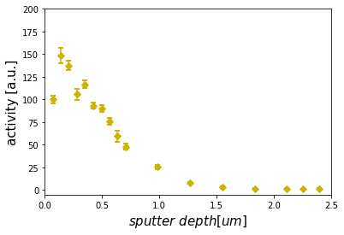
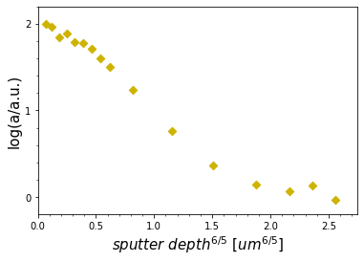
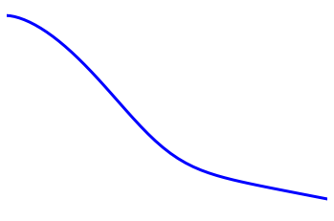
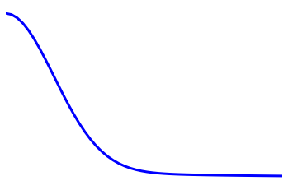
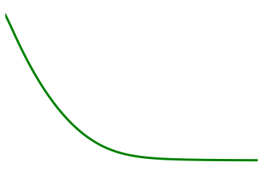
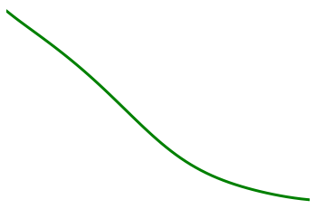
Indium Tracer Diffusion (Beckers, 2015^{[2]})
Non-linear fitting from paper (623K, 17.5h)
Continuum model match:
SeM = 1.02, CGI = 0.9215, GGI = 0.30 (623K, 17.5h)
[2] Beckers, Thomas, Lakshmi Nagarajan, and Manfred Martin. ”Radio-tracer diffusion of 114m In in Cu(In,Ga)Se₂ thin films.” Thin Solid Films592 (2015): 118-123.
Notes:
Then I tested this model on an experiment paper, in which indium tracer is put onto the top of CIGS layer and diffuse into the bulk. Since there are little group III vacancy sites available in the bulk, we assign the indium tracer on the copper sublattice, and perform this simulation. The first two image shows the experiment data points and the non-linear fitting curve in the paper(left one is normal scale, and second one is log scale), and below is the continnum model. I also compared the model with other data in the paper under different temperature. The results are still quite consistent.

Slide 10
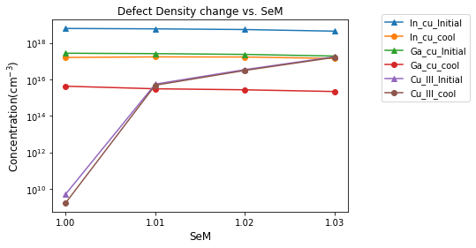
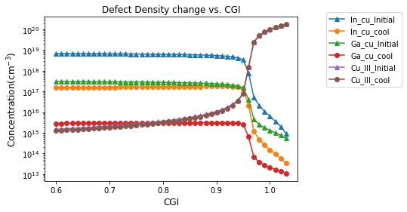
Cooling Process
CGI: 0.85, GGI: 0.35, SeM: 1.01, T: 873K (initial), Ef - Ev: 0.09
(calculated via Compositionally Constrained Thermodynamics (CCT)^{[3]})
CGI: 0.85, GGI: 0.35, SeM: 1.01, T: 300K (cooling, ramp= -0.1C/min)
 | In_cu (+2) | Ga_cu (+2) | Cu_III (0) | Vcu_Vse (+1)
Concentration(cm⁻³) | 1.99e19 | 2.48e18 | 9.19e17 | 8.53e13
 | In_cu (+2) | Ga_cu (+2) | Cu_III (0) | Vcu_Vse (+1)
Concentration (cm⁻³) | 2.32e16 | 5.57e14 | 1.49e16 | 9.16e13
Defect density varies with SeM 1.00~1.03, CGI=0.85, GGI=0.25
Defect density varies with CGI 0.60~1.03, GGI=0.25, SeM=1.02
[3] Sommer, David E., Daniel Mutter, and Scott T. Dunham. ”Defects in Na-, K-, and Cd- Doped CuInSe2: Canonical Thermodynamics Based on Ab Initio Calculations.” IEEE Journal of Photovoltaics 7.4 (2017):1143-1152.
Notes:
One other process we are interested in is the cooling. We know that in silicon manufacture process, defect density can be reduced in the cooling and annealing process. And we found similar phenomenon in CIGS. The data from first table lists deep level defects equilibrium concentration under 873K. The data is obtained through DFT calculated defect formation energy and a tool called CCT developed in our group. CCT can give us the defect equilibrium concentration based on three compositional constraints. Second table is the defect density after cooling. You could see major deep level defects concentration decrease a lot. It’s because they tend to be shallow defect complex after cooling. This means that the cooling process for CIGS could lower the defect concentration and benefit the performance of device. Using this model, we can easily get the defect density distribution with compositional constraints. SeM valence ratio, CGI, …. This model provides a guidance for the composition optimization in CIGS.

Slide 11
Device Simulation(Jackson, P.(2007)^{[3]})
Software: Sentaurus Device Simulation
Optical properties/electrical properties/bandgap structure
SRH recombination, Radiative recombination
Mo
CdS
CIGS
ZnO
AZO
AM1.5 Global
MgF₂
[3] Jackson, Philip, et al. ”High quality baseline for high efficiency Cu(In_{1-x},Ga_{x})Se₂ solar cells.” Progress in Photovoltaics: Research and Applications 15.6 (2007): 507-519.
Notes:
Second is the device simulation, I used Sentaurus Device to do the simulation. Firstly, I built a device structure from the reference experimental paper. And find … properties in the literature. I included … Recom. Lifetime Is also from literature. And I used AM1.5 global spectrum to simulate solar spectrum.

Slide 12
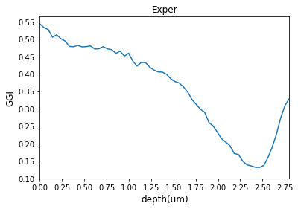
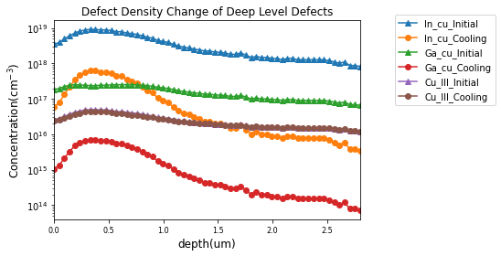
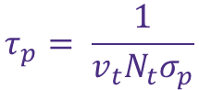
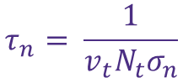

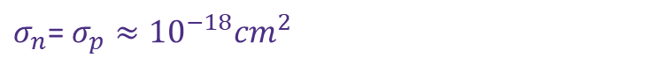
Process
Simulation
Implemented GGI ratio across thin film. Extracted from GDOES profile in the paper. (Jackson, P.(2007)).
Simulated deep level defect concentration via process simulation based on GGI ratio and fixed CGI (0.85) and valence ratio (1.00)
$$R^{SRH}=\frac{np − n_{i}^{2}}{τ_{p}\left(n+n_{1}\right)+τ_{n}(p+p_{1})}$$
Deep level defect: Traps (SRH recombination)
Shallow defect: incomplete ionization donor/acceptor
$$τ_{n}= \frac{1}{v_{t}N_{t}σ_{n}}$$
$$τ_{p}= \frac{1}{v_{t}N_{t}σ_{p}}$$
$σ_{n}$= $σ_{p}≈{10}^{−18}{cm}^{2}$
 | JSC(mA) | Voc(V) | η% | FF | CIGS Thickness(um) | CdS Thickness(um) | ZnO Thickness(um) | AZO Thickness(um) | Mo Thickness(um) | MgF2 Thickness(um)
Experiment(Jackson, P.(2007)) | 34.7 | 0.7113 | 19.0 | 77.1 | 2.8±0.2 | 0.05±0.005 | 0.05 | 0.100 | 1.5±0.2 | 0.100
Sentaurus Device | 34.2 | 0.7204 | 19.9 | 80.9 | 2.8 | 0.05 | 0.05 | 0.055 | 1.5 | 0.072
Comparison between Sdevice and experiment.
(Thickness of MgF2 and AZO have been optimized to reduce reflection)
Notes:
I tried to compare the simulation results with experiment paper. Firstly, I extracted GGI ratio from GDOES profile in the paper and implement into simulation software. And using the structure in the last slide. In the table, the final simulation results is quite consistent with experiment. But it slightly overestimates of Voc and underestimates Jsc. This may be due to Cd surface doping at interface as reported by some other groups. Cd doping will make the interface more n-type, then reduce the electric field in space charge region and facilitate electron transport. We will continue work on it to build more accurate and effective CIGS TCAD models.
(You may find I made some change in AZO and MgF2 layer thickness. It is because we found large variances in refractive index due to different synthesis and deposition processes. But the function of two layers is to reduce reflection of photons which can be absorbed at maximum efficiency. So, I did an optimization of the thickness here.)

Slide 13
Future Plan
Chemical potential-based device simulation
More comparisons between experiments and simulations
2D simulation to explore the effect of ordered vacancy compound (OVC) and grain boundary.

Slide 14



Acknowledgment
Dr. Scott Dunham, David Sommer, Aaron Gehrke, Shifeng Zhu
Department of Energy (DOE), Clean Energy Institute, Molecular Engineering & Sciences Department

Slide 15
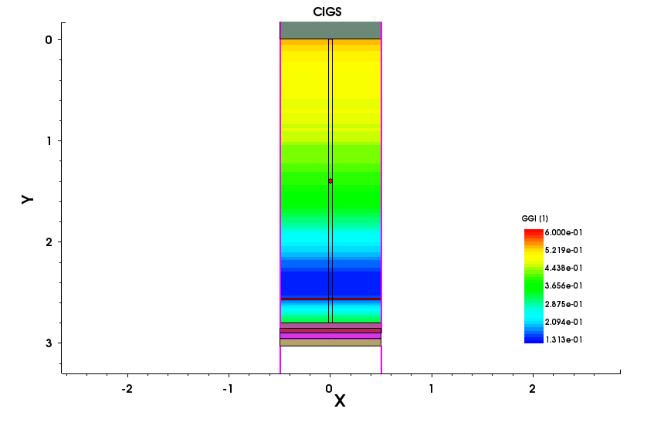
2D simulation
It’s also possible to extend 1D simulation to 2D. So that we can implement grain boundary or other interesting structure into the CIGS solar cell device. In the left side schematic, a grain boundary region has been applied in the middle separated by black lines. In future work, we can change the properties of this region to see how the grain boundary could affect device performance. In current work, we build a small circular region inside grain boundary. This special region has been given a different GGI value from outer region (grain boundary region has identical properties with CIGS). Since bandgap of materials is dependent on GGI ration, the small circle may lead to energy barrier or trap inside the device.

Slide 16
Reference
1. Lee, Dongho, et al. "Effects of the Cu/(Ga+ In) ratio on the bulk and interface properties of Cu (InGa)(SSe) 2 solar cells." Solar Energy Materials and Solar Cells 149 (2016): 195-203.
2. ACS Appl. Mater. Interfaces 2018, 10, 28553−28565
3. Werner, Florian, et al. "Alkali treatments of Cu (In, Ga) Se2 thin‐film absorbers and their impact on transport barriers." Progress in Photovoltaics: Research and Applications 26.11 (2018): 911-923.
4. Werner, Florian, et al. "Can we see defects in capacitance measurements of thin‐film solar cells?." Progress in Photovoltaics: Research and Applications 27.11 (2019): 1045-1058.
5. Eisenbarth, Tobias, et al. "Interpretation of admittance, capacitance-voltage, and current-voltage signatures in Cu (In, Ga) Se 2 thin film solar cells." Journal of Applied Physics 107.3 (2010): 034509.
6. Khelifi, Samira, et al. "Investigation of defects by admittance spectroscopy measurements in poly (3-hexylthiophene):(6, 6)-phenyl C61-butyric acid methyl ester organic solar cells degraded under air exposure." Journal of Applied Physics 110.9 (2011): 094509.
7. Kronik, Leeor, David Cahen, and Hans Werner Schock. "Effects of sodium on polycrystalline Cu (In, Ga) Se2 and its solar cell performance." Advanced Materials 10.1 (1998): 31-36.

